Slide 1

By Justus Karegyeya

Slide 2
Topic outline: Introduction to communication
What is Communication?
The Communication Cycle
Importance of Communication
Types of Communication
Styles of Communication
Organizational Communication Flow
Barriers to Communication
Communicating Effectively

Slide 3
What is Communication?
The dictionary defines communication as:
A process by which information is
exchanged between
individuals through a common
system of symbols, signs or behavior
Communication is a two-way process which involves:
Listening to others (Receiving) message
Asserting/Expressing (Sending)

Slide 4
Perspectives of Communication
Technical Definition
It is the transmission of messages from one person/place to another. It tells us about the technical means/ machinery.
Process Definition
It is a complex & dynamic process of exchanging meaningful messages. It tells us about interpretation & meaning.

Slide 5
Transactional Definition
It is a transaction between participants during which relationships develop. Participants are mutually responsible for the outcome of the communication as they transmit, create meaning & elicit responses.

Slide 6
Goals/Functions/Importance of Communication
To change behavior
To get and give
Information
To get action
To persuade
To ensure understanding

Slide 7
Communication Cycle
Communication normally goes through a cycle involving:
The Sender
The Recipient
The Message
The Channel

Slide 8
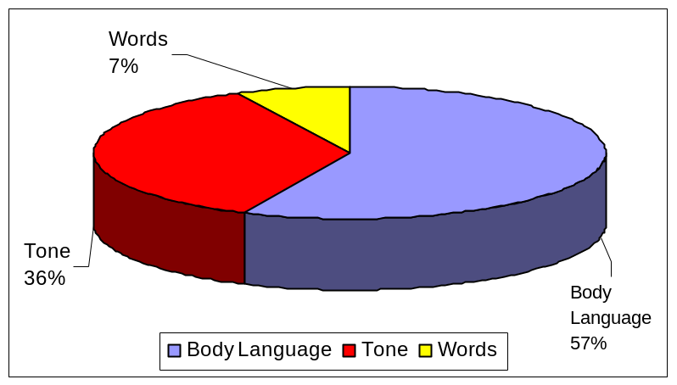
Impact of a Message
Face-To-Face Communication

Slide 9
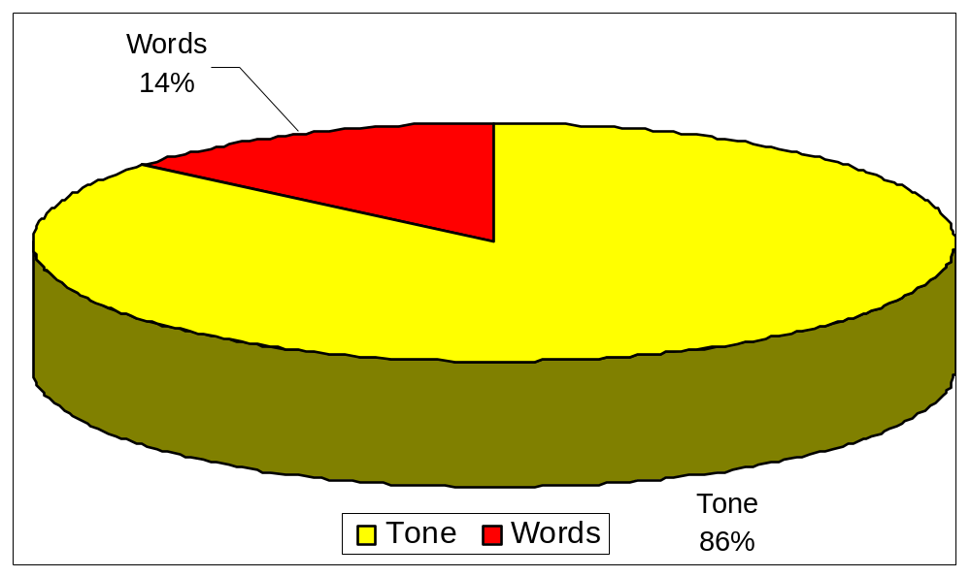
Impact of A Message
Voice Communication

Slide 10
Types of Communication
Communication types are classified according to Channel or Style. Therefore there are two types
Verbal Communication
Words
Voice modulation
Non-Verbal Communication
Communicates emotions and attitudes
Regulates verbal messages

Slide 11
Formal & informal communication
  formal communication - official, organization-sanctioned episodes of information transmission
  informal communication - more unofficial
    grapevine - the social network of informal communications
      helps people to interpret the organization
      conveys information that the formal system leaves unsaid
  Managing informal communication
    managers need to work with the grapevine
    talk to the key people
    prevent rumors from starting
    neutralize rumors once they have started

Slide 12
Verbal Communication
This is comprised of words and voice in both written and spoken forms
Words
  Use simple language (avoid jargon and slang)
  Make sure that you are grammatically correct
  Be clear and precise (avoid redundancy)
Voice Modulation
  Diction
  Tone
  Pitch
  Volume
  Rate

Slide 13
Non-Verbal Communication
This is communication using gestures, symbols, signs, feelings, emotions e.t.c.
Gestures
  Are you aware of how you look to others?
  Find out your habits and nervous gestures
Posture and movement
  Stand tall
Facial Expressions
  Smile
  Eye Communication
90% of our personal communication calls for involvement. To show involvement, look at your audience for 5 to 10 seconds before looking away.

Slide 14
Nonverbal Communication
Actions, gestures, facial expressions, etc.
Transmits most information in face-to-face meetings
Influences meaning of verbal and written symbols
Less rule bound than verbal communication
Important part of emotional labour

Slide 15
Types of Communication based on Style and Purpose
Based on the style of communication, there can be two broad categories of
communication, which are formal and informal communication .
Formal communication includes all the instances where
communication has to occur in a set formal format. Typically this can include
all sorts of business communication or corporate communication. The style of
communication in this form is very formal and official. Official conferences,
meetings and written memos and corporate letters are used for commn.
It can also occur between two strangers when they meet for the first time.
Hence formal communication is straightforward, official and always precise and has a stringent and rigid tone to it.

Slide 16
Informal Communication
Informal communication includes instances of free unrestrained communication between people who share a casual rapport with each other. Informal communication does not have any rigid rules and guidelines. Informal conversations need not necessarily have boundaries of time, place or even subjects for that matter since we all know that friendly chats with our loved ones can simply go on and on.

Slide 17
Forms of Communication
Forms of Communication in the Workplace
Business Letters
Memos
Presentations
Notices
Agenda
Announcements
Meetings
Policies
Group Discussions

Slide 18
Forms of Communication Ctd.
Forms of Communication in Business
Advertisements
Memos
Letters
Declarations
Press Releases
Campaigns
Annual General Meetings
Publications
Researched Articles for Journal
Addressing to the Public at Large
Manuals and Notices
These were the forms of communication in a corporate organization.

Slide 19
Settings/Levels of Communication
Intra – personal Communication
Interpersonal Communication
Small group Communication
Large Group Communication
Public Communication
Mass Communication

Slide 20
Communication
Rights and Responsibilities
Rights
Responsibilities
You have the right to be treated with respect.
You have the right to have and express your own opinions.
You have the right to ask for what you need in order to be effective.
You have the right to set reasonable limits.
You have the responsibility to treat others with respect.
You have the responsibility to listen to the opinion of others.
You have the responsibility to acknowledge and address the needs of others.
You have the responsibility to respect the limits and boundaries of others.

Slide 21
Styles of Behaviour in Communication
Passive
Assertive
Aggressive
Accepts responsibilities.
Extends but does not feel entitled to “rights” .
Both exercises and extends “rights” and responsibilities.
Demands but does not extend “rights”.
Does not accept responsibilities.

Slide 22
Effective Listening Involves. . . To be comprehensively Covered later
Setting the stage
Remove Distractions
Be open and accessible
Listen with Empathy
Ensuring Mutual Understanding
Reflect feelings
Paraphrase main ideas
Seek clarification
Confirm next steps
Understanding body Language
Observe position and posturing
Make eye contact
Consider expressions/gestures
Suspending judgment
Concentrate
Keep an open mind
Hear the person out
.

Slide 23
3 Types of Listening
Passive Listening
Active Listening
Hearing

Slide 24
Listening and Speaking
Listening takes:
Concentration and energy
Curiosity and open-mindedness
Analysis and understanding
Speaking requires:
Sharp focus
Logical thinking
Clear phrasing
Crisp delivery

Slide 25
Organizational Communication Flow
Upward
Information, Answers &Outputs
Downward
Giving Instructions
Directives
Horizontal
Coordination & Collaboration

Slide 26
Vertical / Linear Communication
Upward Communication
  Consists of messages sent up the line from subordinates to bosses.
  Includes employee suggestions, reactions to organizational policies, inquiries or concerns.
Downward Communication
  Flows from individuals in higher levels of the organization to those in lower levels.
  Includes meetings, official memos, policy statements, manuals, and organizational publications.

Slide 27
Horizontal Communication
The horizontal information flow that occurs both within and between departments.
Generally, the purpose of lateral communication is coordination and collaboration.

Slide 28
Barriers To Effective Communication
Assumptions
Psychological
- Emotional- fear, shyness & aggression
Language
Vocabulary, ambiguity, j argon, fuzzy use of language
Fears
  Reluctance to confront
  Ridicule, rejection, fear of being wrong
Values and attitudes
Generation Gap
Information overload
  When the information we can process is exceeded
Trust and Honesty
  A lack of trust can cause the receiver to look for hidden meanings in the sender’s message.
Cross-Cultural Diversity
  The greater the difference between the sender’s and receiver’s cultures, the greater the chance for miscommunication.

Slide 29
Key To Communicating Effectively
Know your subject.
Focus on the purpose.
Know your audience.
Use a confident tone and a level pitch.
  Be calm and collected at all times.
  Try to eliminate excessive “ums” and “uhs” as fillers.
Speak slowly and make use of pauses to stress important ideas.
  Use accurate diction and correct pronunciation
Know what you are talking about and accept the limitations of your knowledge.
Be vibrant and enthusiastic.
  Avoid a dull, monotonous tone.
  Be loud enough to be easily heard.

Slide 30
Barriers to communication
can lead to misunderstanding and confusion
.

Slide 31
Remember. . .
Effective communication encompasses a multitude of skills.
Skills can be learned and practiced.

